Slide 1


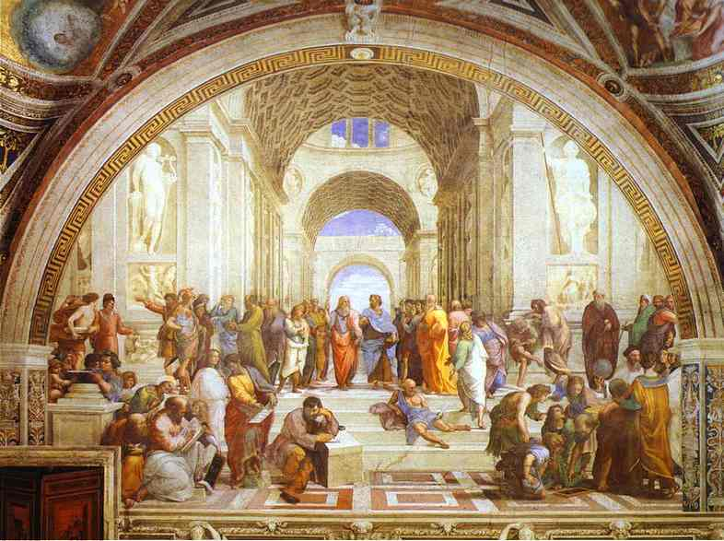
Computer Networks Performance Evaluation

Slide 2
Chapter 15
Non Product-Form Queuing Models
Performance by Design:
Computer Capacity Planning by Example
Daniel A. Menascé, Virgilio A.F. Almeida, Lawrence W. Dowdy
Prentice Hall, 2004

Slide 3

Chapter 15-Outlines
15.1. Introduction
15.2. Modeling High Service Time Variability
15.3. Modeling Blocking Effects
15.4. Modeling Priority Scheduling
15.5. Modeling Software Contention
15.6. Modeling Fork/Join Queuing Networks
15.7 Concluding Remarks
15.8 Exercises
Bibliography

Slide 4
Introduction
Most modern computer systems exhibit features that violate the assumptions required by product-form networks.
Some system features that violate separable assumptions are:
  blocking,
  high service time variability at FCFS centers,
  simultaneous resource possession,
  process forking and synchronization, and
  priority scheduling.
These features cannot be modeled directly by product-form models.

Slide 5
Introduction’
Thus, many algorithms have been developed to approximate the solution of models that incorporate non product-form features.
These algorithms
  share same basic ideas,
  accept a queuing network model that has some nonseparable features, and
  transform it into an approximate network that obeys the BCMP conditions [8].
Some algorithms rely on models that use heuristic extensions to the approximate MVA equations [18, 39].

Slide 6
Introduction’’
The approximate QN has a product-form solution and gives approximate measures on the performance of the original model.
The input parameters of the original model are either transformed by means of an iterative process or by approximations that resemble the effects of the feature being modeled.
Once the new parameters are obtained, an MVA algorithm is used to calculate the performance measures of the approximate network.

Slide 7
Introduction’’’
Some kind of transformation may be required to map the results of the approximate model back to the original one.
The following sections present approximate techniques for modeling non product-form queuing models.

Slide 8
Chapter 15-Outlines
15.1. Introduction
15.2. Modeling High Service Time Variability
15.3. Modeling Blocking Effects
15.4. Modeling Priority Scheduling
15.5. Modeling Software Contention
15.6. Modeling Fork/Join Queuing Networks
15.7 Concluding Remarks
15.8 Exercises
Bibliography

Slide 9
Modeling High Service Time Variability
Examples of high variability abound in computer systems.
For instance, the Web shows extreme variability in workload characteristics, including file sizes and file popularity [15].
As another example, it has been shown that network arrivals, measured by packet interarrival times, are not exponentially distributed [28]. The
authors also show that Poisson models underestimate the burstiness of TCP
traffic.

Slide 10
Modeling High Service Time Variability’
What are the sources of variability in computer systems?
They are various. Here are some examples: sizes of data objects [27], files stored on Web servers [15], flow lengths traveling through the Internet, files stored in file systems [17], and process lifetimes.
It is important to be able to model high service time variability, because increasing variability usually affects the performance of a system. As pointed out in [6], even a small amount of HTTP traffic burstiness degrades the throughput of a Web server.

Slide 11
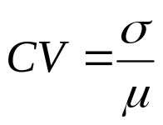
Modeling High Service Time Variability’’
The variability of a dataset can be captured by the coefficient of variation (CV), defined as the ratio of standard deviation (σ) to the mean (μ).
Eq. 15.2.1
The characteristics of the distribution function of a random variable show if the random variable has high variability.
For example, the tail of a distribution (i.e., the probability that the random variable is greater than a given value) shows the likelihood of large observations.

Slide 12


Modeling High Service Time Variability’’’
Distributions whose tail decline with a power law are called heavy-tailed. Power-laws are expressions of the form , where is a constant and x and y are the measures of interest.
Measurements of several systems (e.g., Internet, WWW, Ethernet traffic, file systems) show numbers that exhibit a pattern known as "heavy-tailed" [15, 17, 27]. This means that very large numbers could be present in samples of measurements, such as number of bytes transmitted, file sizes and CPU times.
These extremely large numbers do affect the performance of a system and should not be ignored.

Slide 13


Modeling High Service Time Variability’’’’
A random variable X follows a heavy-tailed distribution if where is a slowly varying function.
A Pareto distribution is a special case of heavy-tailed distribution where the number of events larger than x is an inverse power of x.
Among other implications, a heavy-tailed distribution presents a great degree of variability, and a non-negligible probability of high sample values.
Common distributions, such as the exponential distribution, decay much faster than heavy-tailed distributions.

Slide 14

Modeling High Service Time Variability’’’’’
In a log-log plot, is a straight line with
inclination –a. Depending on the value of a, a power law distribution may have infinite mean (if a < 1) or infinite variance (if a < 2). In practice, these statistics do not occur because values are limited by measured data.
Once the importance of variability is recognized, this section presents techniques to analyze models with non-exponential FCFS queues. These techniques were consolidated by Eager, Sorin, and Vernon in [18].

Slide 15

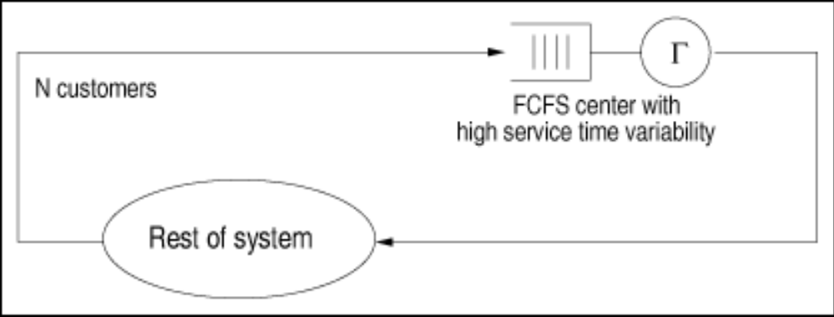
The Decomposition Approach
Consider a closed single-class queuing model with N customers and a FCFS queuing center that has exponentially distributed service time (see Fig. 15.1).
Figure 15.1. FCFS service center with high service time variability.

Slide 16


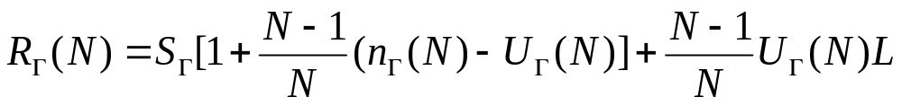


The Decomposition Approach’
Let be the average service time at this service center. When the service time of service center is not exponentially distributed and has a coefficient of variation
, the response time at can be approximated by Eq. 15.2.2
Where is the utilization of the service center , is the average queue length at , and L is an estimate [31] (given below) of the mean residual service time of the customer in service at an arrival instant, considering that arrivals do occur at random points in time.

Slide 17
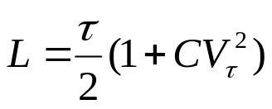
The Decomposition Approach’’
Note that Eq. (15.2.2) uses the Schweitzer [35] approximation for the response time equation already discussed in Chapter 13.
Eq. 15.2.3

Slide 18
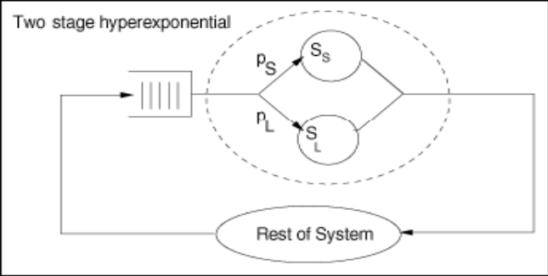
The Decomposition Approach’’’
An alternative approach to solving QN models with high service time variability was proposed in [41].
First of all, the service center Γ with high service time variability is synthesized as having a hyperexponential service time distribution as shown in Fig. 15.2.
Figure 15.2. Model of a queue with high service time variability.

Slide 19









The Decomposition Approach’’’’
With probability , customers who visit service center experience a "short" exponentially distributed service time with average . With probability , customers have a "long" exponentially distributed service time with average .
The problem now is given an empirical service time distribution at service center with average service time and coefficient of variation find the values of that match and .

Slide 20

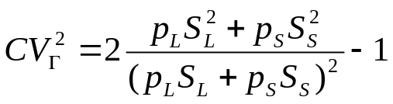
The Decomposition Approach’’’’’
It can be easily shown (see Exercise 15.1) that
Eq. 15.2.4
Eq. 15.2.5

Slide 21
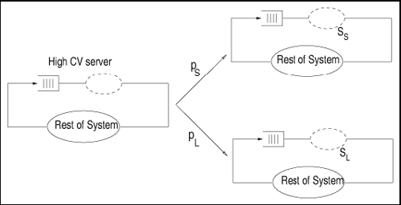
The Decomposition Approach’’’’’’
One can now explain, with the help of Fig. 15.3, how the approach proposed in [41] works.
The QN on the left of the figure is replaced by two QNs.
Fig. 15.3. Model of a QN with a two-stage hyperexponential service center.

Slide 22

The Decomposition Approach’’’’’’’
In each one of them, the hyperexponential service center is replaced by an exponential service center with average service time in one case and in the other.
These two QNs are product-form QNs and can be solved by the methods discussed previously in the book.
Based directly on the theory of near-complete decomposability [14], the performance metrics of the original network (i.e., the one with the hyperexponential service center) can be obtained as the weighted averages of the performance metrics of the two product-form QNs. The weights are the probabilities and

Slide 23
The Decomposition Approach’’’’’’’’
Advantage : The decomposition approach captures well the behavior of models with high service time variability. This technique yields results within 15% of the exact values over the large region of the parameter space [18].
Disadvantage : A disadvantage of this method is its complexity for solving models that contain many centers with high service time variability.

Slide 24


MVA-based Decomposition Approach
Instead of decomposing the model into two independent QN models, the approach described in this section applies the decomposition principle only to each individual service center with high service time variability [14].
This is done by modifying the MVA equations for these service centers only and keeping the regular MVA equations for the other service centers.
Let be a service center with high service time variability and let and be the service demands at considering the short and long service times discussed earlier.

Slide 25






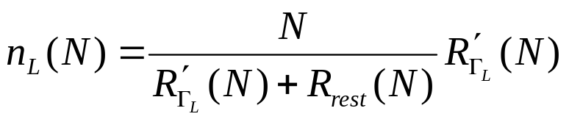
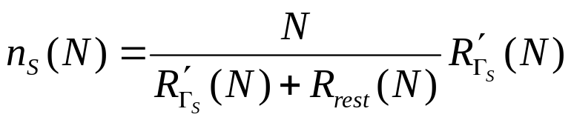
MVA-based Decomposition Approach’
Then, the residence time at can be written as
Eq. 15.2.6
where and are as before and and are computed as follows
Eq. 15.2.7
Eq. 15.2.8
Eq. 15.2.9
Eq. 15.2.10

Slide 26


MVA-based Decomposition Approach’’
Eqs. (15.2.7) and (15.2.8) are the well-known MVA residence time equations with the difference that they use the proper service demand (long or short) and the proper expressions for queue length given in Eqs. (15.2.9) and (15.2.10).
The queue length equations for follow the well-known MVA queue length equations with the difference that, in each case, the throughput (i.e., N divided by the response time) includes the short or long residence time plus the residence time, , in the rest of the QN.

Slide 27
Example 15.1.
Consider a mail server with a powerful processor and one large disk subsystem. The analyst wants to model the system to analyze the future performance of the server under different workload scenarios. When choosing the abstraction to model the mail server, it was decided to use a closed QN model because during peak times the mail server has a constant (i.e., maximum) number of processes handling incoming and outgoing messages. A study of mail server workloads [9] shows that message size statistics exhibit a large coefficient of variation.

Slide 28
Example 15.1.’
Assuming the processor time to process a message is proportional to the size of the message, it is necessary to include high service time variability at the processor in the model. Assume that the following input parameters were obtained through measurements:
where "p" and "d" stand for processor and disk, respectively.
What are the throughput and response time of the mail server?

Slide 29
Example 15.1.’’
Consider two solution techniques : The first ignores the high variability for the service time at the processor and the other uses the modeling approach described earlier.
1. The processor is modeled as an exponential FCFS center. Using the regular MVA equations (see Chapter 12), yields the following results for response time and throughput: 1.42 sec and 141 mes/sec, respectively.

Slide 30





Example 15.1.’’’
2. Using the decomposition technique to model processor service time.
Assume that and set . The solution of Eqs. (15.2.4) and (15.2.5) yields and
. Using these values, one solves two MVA models, as shown in Fig. 15.3, yielding the following response times:
.
Thus, the response time in the QN with high variability is equal to 0.1 x 2.872+0.9 x 1.42 = 1.57 sec and the throughput is equal to 133.7 mes/sec.
Note that the exponential service time model overestimates the performance of the mail server.

Slide 31
Chapter 15-Outlines
15.1. Introduction
15.2. Modeling High Service Time Variability
15.3. Modeling Blocking Effects
15.4. Modeling Priority Scheduling
15.5. Modeling Software Contention
15.6. Modeling Fork/Join Queuing Networks
15.7 Concluding Remarks
15.8 Exercises
Bibliography

Slide 32
Modeling Blocking Effects
Blocking is a general phenomenon in computer systems, which occurs when the operation of a system component is suspended because of the unavailability of resources elsewhere in the system [3].
The literature [11] reports three different types of blocking :
  blocking after service,
  blocking before service, and
  repetitive blocking.
the latter occurs when a customer at service center j wants to go to center k, whose queue is full. In this case, the customer is rejected at center k and goes to the rear of the queue of center j.

Slide 33
Modeling Blocking Effects’
This section shows how to model blocking before service, i.e., blocking that occurs when the customer to be served next at center i determines that its next service center is j before entering service at i. If j is already full, the customer cannot enter the service center i and this center is therefore blocked.
For example, when the load of a mail server becomes higher than a given threshold, the server queues messages rather than attempting to deliver them. In other words, the send message service is blocked until the load decreases and the system can resume an adequate throughput.

Slide 34
Modeling Blocking Effects’’
Another example is that of a Web server [5], which typically handles multiple client requests simultaneously. These requests share the the server components (e.g., the processor, disk, memory, and network interface). A common architecture for a Web server consists of a number of processes, where each process handles one request at a time. When the TCP connection is established, the server removes it from the SYN-RCVD queue and places it in the listen sockets queue (i.e., acceptance queue) of connections awaiting acceptance from the Web server [6].

Slide 35
Modeling Blocking Effects’’’
Usually, a Web server imposes a limit on the number of simultaneous processes [5], also called maximum number of clients. Thus, a request may get blocked at the acceptance queue until the server load falls below the maximum number of clients threshold.
The maximum number of processes that may be active simultaneously depends on factors such as available memory, disk subsystem capacity, and the expected load on the server.
When the number of requests being served reaches the maximum number of processes, an arriving request must wait in the blocking queue, as illustrated in Fig. 15.4.

Slide 36
Modeling Blocking Effects’’’’
Figure 15.4 depicts a representation of a system with a blocking queue. The number of available processes is represented by a pool of tokens. If all tokens are occupied, an arriving request must wait. Once a request acquires a process (represented by a token), it becomes ready to use processor and I/O components.
When a request is completed, another request is selected from the blocking queue to be executed by the system.
After completing execution, a process releases the token, which is immediately assigned to a process in the blocking queue. If the queue is empty, the token returns to the pool of available resources.

Slide 37
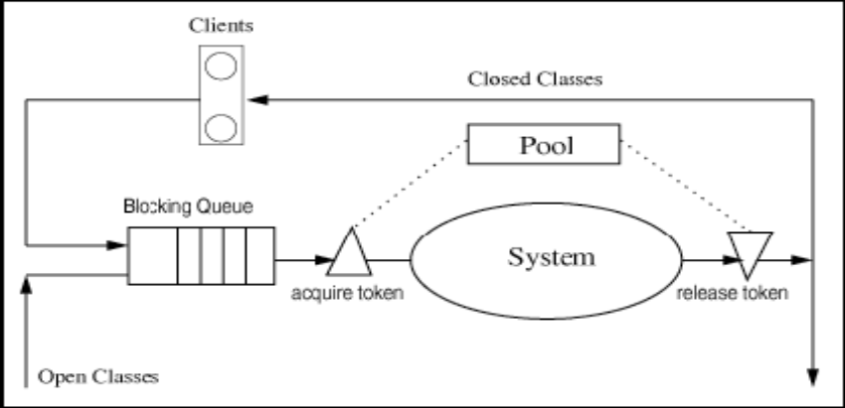
Modeling Blocking Effects’’’’
Figure 15.4. A system with a blocking queue.
Given that this model cannot be solved directly by product-form (e.g., MVA) algorithms, an approximate solution is required.
Techniques for solving non product-form models rely heavily on the use of the flow-equivalent concept, which was introduced in Chapter 14, as the decomposition/aggregation technique

Slide 38
Modeling Blocking Effects
“Single Class”
Let J denote the maximum number of transactions that may be executed simultaneously in a transaction system.
When a transaction arrives and finds J transactions in execution, it has to wait outside the system, in a blocking queue.
When a transaction completes execution, another one, from the blocking queue, is admitted into the system.
Consider for now that a single-class queuing model is used to represent the computer system with blocking.

Slide 39
Modeling Blocking Effects
“Single Class” ’
The workload consists of transactions processed by the system and can be modeled either by an open class (transaction type) or by a closed class (interactive type).
In both cases, the blocking effects appear when the number of transactions to be executed exceeds J. This situation generates a blocking queue, whose length varies with time.
The solution of single-class models with blocking queuing is typical of many other non product-form models. It proceeds in five steps.

Slide 40
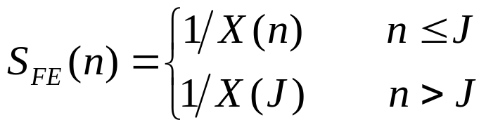
Modeling Blocking Effects
“Single Class” ’’
1. Consider the system in isolation ignoring the external arrivals of transactions.
2. For each feasible customer population (i.e., from 0 to J transactions), solve the model in isolation and obtain the throughput as a function of the population, X(n), n = 0, 1, 2, ..., J. Use either the exact or the approximate MVA algorithm to solve the model.
3. Define a flow-equivalent (FE) server to replace the system. The service time of the flow-equivalent server depends on the load of the system and is given by :

Slide 41
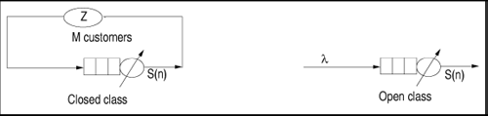
Modeling Blocking Effects
“Single Class” ’’’
4. Create a reduced model with the flow-equivalent server and the external workload.
Fig. 15.5 shows the reduced models for the two representations of the workload.
Figure 15.5. Reduced models of a system with blocking queuing.

Slide 42
Modeling Blocking Effects
“Single Class” ’’’’
For an interactive workload, the reduced model is closed with population equal to M, the number of clients associated with the class.
In addition to the flow-equivalent server, the model has a delay server that represents the average think time (Z).
The interactive model can be viewed as having M transactions, which alternate between execution in the flow-equivalent server and thinking in the delay server.
The reduced model of the transaction class is an open model with a flow-equivalent server and arrival rate λ.

Slide 43
Modeling Blocking Effects
“Single Class” ’’’’’
5. Solve the reduced model.
The closed model can be solved using the single class MVA algorithm with load-dependent devices, described in Chapter 14.
The solution of the open model follows that of the birth-death model provided in Chapter 10.

Slide 44


Example 15.2.
A database server has a processor and two disks (D1 and D2) and is responsible for processing transactions that access the database. For workload characterization purposes, the transactions are grouped into a single class, which means that they are somehow similar. A typical transaction is characterized by the following service demands:
The arrival rate is . With the purpose of keeping the example simple, the maximum number of transactions was set to three (i.e., J = 3).

Slide 45


Example 15.2.’
The performance analyst wants to evaluate the effect of the blocking queue (bq) on the transaction response time. In other words, the model should be able to calculate the percentage of the response time that a transaction spends waiting in the blocking queue, before being admitted for execution (%bq).
To answer the question, the analyst needs to calculate the average response time and the average waiting time in the blocking queue.

Slide 46
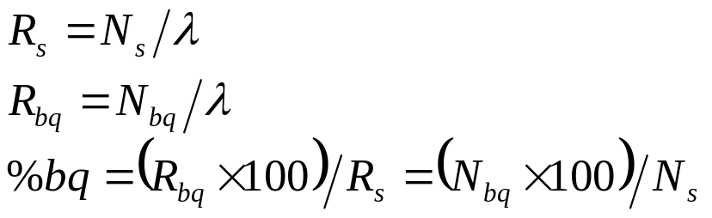


Example 15.2.’’
From Little's Law, it follows that
Eq. 15.3.11
where is the average number of transactions in the system and is the average number of transactions waiting for execution.
Following the steps to solve a non product-form model, one first calculates the server throughput in isolation for all possible populations.

Slide 47


Example 15.2.’’’
In this case, because of the memory constraint, the server can have at most three transactions in execution (n = 1, 2, 3).
The single-class MVA algorithm of Chapter 12 yields X(1) = 1 tps, X(2) = 1.413 tps, and X(3) = 1.623 tps. With these results one can define a flow-equivalent server for the database system.
The reduced model is an open system with a load-dependent server and arrival rate . Using the results introduced in Chapter 10 for birth-death models one is able to calculate , the probability that there are k transactions in the system.

Slide 48



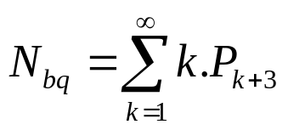

Example 15.2.’’’’
Thus, letting , the probabilities
are obtained.
The value of can be obtained from the probabilities as
Eq. 15.3.12
since when there are k (k > 1) transactions in the blocking queue there are k + 3 in execution.
Using the probability values in Eq. (15.3.12) yields

Slide 49


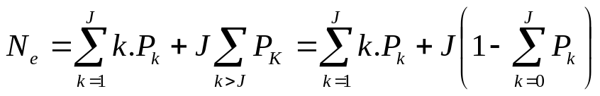


Example 15.2.’’’’’
The average number of transactions in the system is given by
Eq. 15.3.13
where is the average number of transactions in execution given by
Eq. 15.3.14
Substituting the values of and J into Eq. 15.3.14, yields .

Slide 50
Example 15.2.’’’’’’
Thus, the average number of transactions in the system is 1.99 and the percentage of time that a typical transaction spends in the blocking queue is (0.474 x 100)/1.99 = 23.8%.

Slide 51



Modeling Blocking Effects
“Multiple Classes”
The queuing network models considered here contain K service centers and a number R of different classes of customers.
Among the customer classes, C classes have blocking queues, specified by the maximum number of transactions of each class, , c = 1, 2, ..., C.
For example, consider a simple two-class model with a processor and two disks. The workload consists of two classes of transactions: queries (q) and updates (u).
The execution mix can have at most four queries and one update simultaneously

Slide 52

Modeling Blocking Effects
“Multiple Classes” ’
The two classes are characterized by their arrival rates, .
Typical capacity planning questions are:
What is the effect on the system performance of the doubling the maximum number of transactions in execution at the same time?
To answer these questions, one needs to introduce first approximate solution techniques for the blocking queuing problem.

Slide 53
Modeling Blocking Effects
“Multiple Classes” ’’
Brandwajn [10] and Menascé and Almeida [24] independently developed a non-iterative solution technique for multiple-class models with memory constraints, i.e., blocking characteristics.
Basically, the technique requires the calculation of throughputs for all possible combinations of customer populations.
These throughputs feed a series of single-class models, whose results are then combined into the solution of the original problem.
Although accurate, the technique has a high computational cost.

Slide 54

Modeling Blocking Effects
“Multiple Classes” ’’’
An iterative approximation, developed by Brandwajn [10] and Lazowska and Zahorjan [23], circumvents the problem of computing throughputs for all populations. However, as pointed out in Ref. [37], the iterative algorithm tends to be less accurate than the first technique.
The basic approach of the iterative technique developed in Ref. [23] is to reduce a multiclass model to a set of single-class models. To achieve this goal, two assumptions are introduced :
  Independence. It is assumed that the average class i population in the blocking model is independent of class j population.

Slide 55
Modeling Blocking Effects
“Multiple Classes” ’’’’
  Average Population. It is assumed that the throughput of class i given ni customers in the model depends only on the average population of the other classes.
The first assumption allows the creation of flow-equivalent servers for each blocking class c (c = 1, 2, ..., C).
The second assumption avoids the calculation of throughputs for all possible population configurations.

Slide 56



Modeling Blocking Effects
“Multiple Classes” ’’’’’
The throughput of a given class i with population
is obtained from the evaluation of the multiclass model with class i customers and with other class populations fixed at their average values,
The average customer population can be obtained by an iterative process that evaluates the single-class model of each blocking class.
The full description of the algorithm proposed by Lazowska and Zahorjan [23] blocking models with multiple classes is as follows :

Slide 57


Modeling Blocking Effects
“Multiple Classes” ’’’’’’
1. Initialize the average population of each blocking class. To obtain an initial estimate for the average population of each blocking class, solve the original multiclass models without blocking. If class c is of type transaction, it should be modeled as an open class. If class c is of type interactive, it should be modeled as a closed class. For each blocking class, set the estimate to the minimum between and the average class c population obtained by solving the unconstrained model. Thus, the outcome of this step is a set of estimates for .

Slide 58






Modeling Blocking Effects
“Multiple Classes” ’’’’’’’
2. Create a transformed multiclass model. The type of a blocking class is either transaction or interactive. Change the original type to a closed, with population equal to . The unconstrained classes remain unchanged.
3. For each blocking class c = 1, ..., C do:
a. Calculate the throughputs These throughputs are obtained through the solution of the transformed multiclass model when is substituted for The population for class s remains fixed at . The model has to be solved times.
b. Define a single-class model with memory queuing and throughputs .

Slide 59


Modeling Blocking Effects
“Multiple Classes” ’’’’’’’’
c. Using the FESC-based algorithm of Section 15.3.1, solve the single class model.
d. Using Eq. 15.3.14, calculate , the average number of class c customers in execution. Let
.
4. Repeat step 3 until successive values of are sufficiently close (i.e., the percentage difference between successive iterations is smaller than a set tolerance).
5. Obtain performance results for the C constrained classes from the solution of the C single-class models of step 3.

Slide 60
Modeling Blocking Effects
“Multiple Classes” ’’’’’’’’’
6. Obtain performance results for the (R – C) unconstrained classes from the solution of the transformed multiclass model (step 2), which take as input parameter for the blocking classes the final values for obtained in step 3.

Slide 61
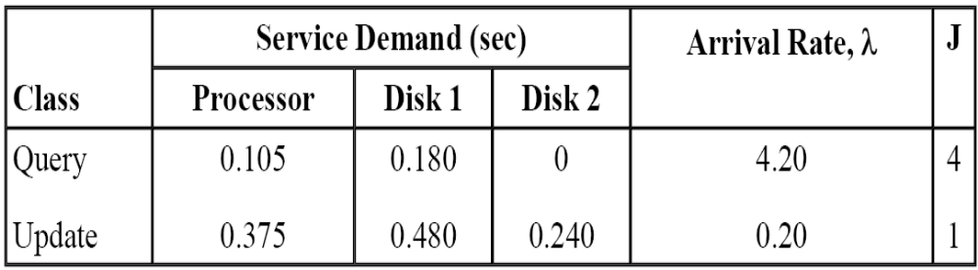
Example 15.3.
Consider again the simple two-class model described in the beginning of this section. Table 15.1 displays the parameters that characterize the model.
Table 15.1. Input Parameters for the Two-Class Model

Slide 62

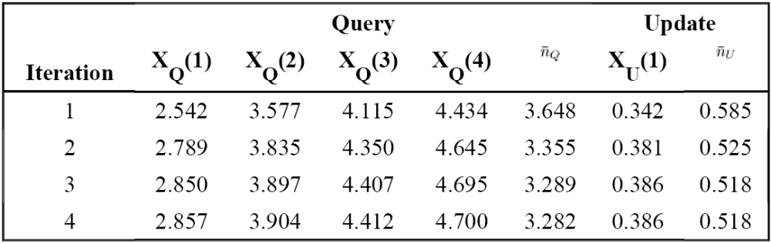
Example 15.3.’
Step 1 of the algorithm requires that one solves an open multiclass unconstrained model as given in Chapter 13. The resulting values of the average population are 6.0192 and 0.8540 transactions for classes query and update, respectively. So are initialized as
Table 15.2. First Four Iterations for Multiclass Example

Slide 63



Example 15.3.’’
Table 15.2 shows the first four iterations of step 3 of the algorithm. The columns labeled through display the throughputs obtained in step 3a for class query, and the column labeled
shows the throughput obtained in the same step for class update.
The columns labeled display the values obtained in step 3d derived from the solution of a FESC model for classes query and update, respectively.

Slide 64


Example 15.3.’’’
For instance, if one wanted to stop at iteration 4, the response time for update transactions would be obtained by dividing the average number of transactions in the system obtained by solving the FESC model (1.077 in this case) by the average arrival rate (0.2 tps). The resulting response time would then be 5.83 sec.
Table 15.3 shows the solution of this example for a tolerance of . This table shows that an update transaction spends, on average, 51.74% of the response time waiting for execution. It is clear that the system needs more processes to execute the transactions.

Slide 65
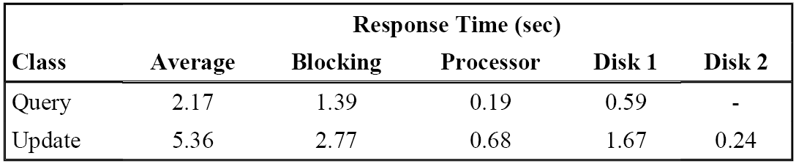
Example 15.3.’’’’
Table 15.3. Response Time Profile per Service Center
The same model can be used to investigate the effect on the performance of update transactions of an increase in the maximum number of processes.

Slide 66

Example 15.3.’’’’’
Assume that the maximum number of update transactions in execution is doubled. Thus, letting and solving the model again, one obtains 3.09 sec and 2.33 sec for the average response times of updates and queries, respectively.
In this case, an update transaction would spend only 0.29 sec waiting for execution.

Slide 67
Chapter 15-Outlines
15.1. Introduction
15.2. Modeling High Service Time Variability
15.3. Modeling Blocking Effects
15.4. Modeling Priority Scheduling
15.5. Modeling Software Contention
15.6. Modeling Fork/Join Queuing Networks
15.7 Concluding Remarks
15.8 Exercises
Bibliography

Slide 68
Modeling Priority Scheduling
Priority scheduling schemes have been used for managing and controlling resource allocation in many types of computer systems, such as database management systems [12], Web servers [1], operating systems [23] and in utility grid environments.
In Web servers, priority-based request scheduling at both user and kernel level has been used to provide different levels of quality of service among clients [1].

Slide 69
Modeling Priority Scheduling’
Most operating systems use priorities as a way to implement a processor scheduling policy. Newly arriving high-priority processes are given the processor, even though processes of lower priority may have been waiting longer for the processor.
Priority scheduling may be preemptive or non-preemptive. In the preemptive case, processes lose control of the resource when processes of higher priority arrive. The suspended processes resume their execution when there are no processes of higher priority waiting for the processor. This is called preemptive resume priority scheduling. This is the type of priority scheduling that is considered in this section.

Slide 70
Modeling Priority Scheduling’’
In the non-preemptive case, low-priority processes are never interrupted by processes of higher priority while being served.
Unfortunately, the use of priority as a scheduling discipline violates the conditions given in Chapter 13 for the existence of a product-form solution for QNs. This means that an approximate solution is needed.
The motivation for the approximation is shown through an example. Then, the general algorithm is presented.

Slide 71
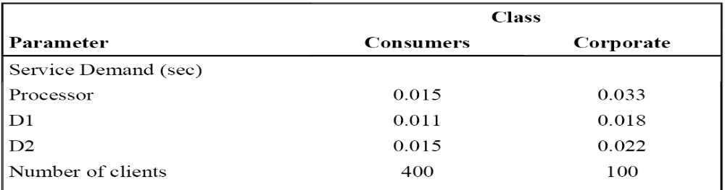
Two-Priority Example
Consider a server composed of a powerful processor and two disks (D1 and D2) used to support an interactive service with 500 simultaneous clients. The total workload may be further decomposed into two workloads :
  corporate partners, and
  consumers.
Table 15.4. Input Parameters for Priority Example

Slide 72
Two-Priority Example’
Table 15.4 presents the service demands and workload intensity parameters for the two workloads.
Since corporate partners have a more strict response time requirement, one would like to answer the following questions :
  How would the response time of the corporate partner and consumer workloads classes change if one assigned a higher CPU scheduling priority to the corporate partners?
  Would the response time for the consumer class be increased significantly?

Slide 73
Two-Priority Example’’
Before answering these questions, one must use the models to obtain the average response time of both classes when both of them have the same priority.
The model is composed of four devices :
  a delay device to represent the think time at the clients,
  three queuing load-independent devices to represent the processor, and
  the two disks.
The following response times are obtained with the multiclass MVA algorithm (see Chapter 13) : 3.74 sec and 1.75 sec for corporate and customer classes, respectively.

Slide 74
Two-Priority Example’’’
The modeling of priorities is considered now. For that matter, the approach called StepWise Inclusion of Classes (SWIC) is used [2].
Note that the consumer class does not interfere at all with corporate requests at the CPU since the latter have preemptive priority at the CPU over the former. Thus, in this respect, corporate requests see the CPU as if it were dedicated to them. On the other hand, consumer requests see the portion of the CPU that is left after corporate requests have used it.
On the remaining part of the computer system (i.e., the I/O subsystem), both classes have the same priority.

Slide 75
Two-Priority Example’’’’
Start by obtaining an estimate of the CPU utilization due to the corporate class only. This can be done by building a model with the corporate class as the only class.
Now, build a model with both the corporate and consumer classes and an additional processor, called shadow processor (see Fig. 15.6).

Slide 76
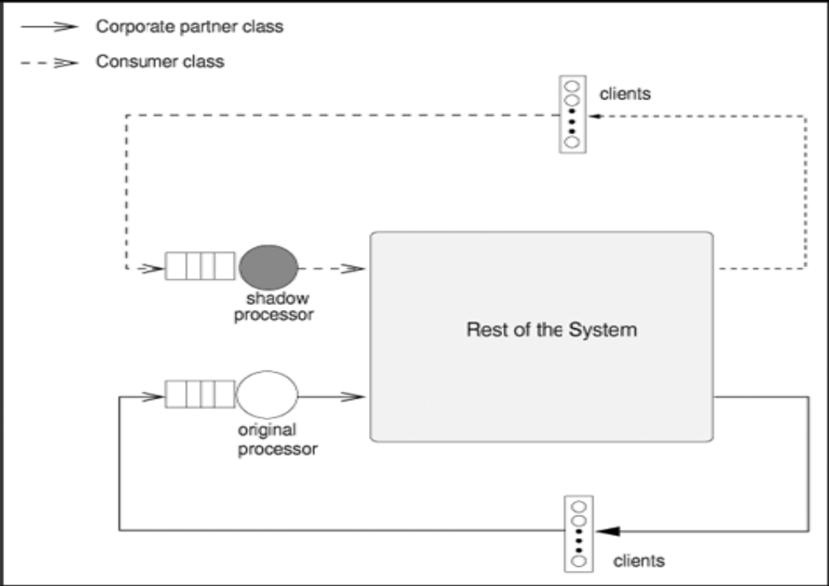
Two-Priority Example’’’’’
Figure 15.6. Shadow CPU for priority modeling.

Slide 77


Two-Priority Example’’’’’’
The use of the original and shadow processors by corporate and consumer classes is governed by the following rules :
  corporate requests use only the original CPU.
  consumer requests use only the shadow CPU.
The problem now is how to compute the service demands of the original and shadow CPUs,
, respectively, for class r, where r may be p (for corporate) or c (for consumer).
Since each class uses only its own dedicated CPU, it follows that .

Slide 78


Two-Priority Example’’’’’’’
Since the corporate class has higher priority over the consumer class, its service demand at the original CPU is equal to its CPU service demand . Hence,
The CPU service demand of consumer requests at the shadow CPU has to be inflated to reflect the fact that it will take these requests longer to go through the CPU due to the presence of higher-priority requests.
The higher the CPU utilization due to corporate requests, the more the service demand of consumer requests has to be inflated.

Slide 79

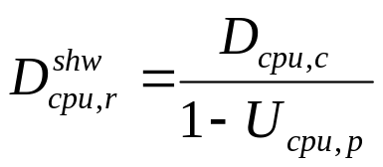
Two-Priority Example’’’’’’’’
The inflation factor has the desired properties. Thus,

Slide 80
Two-Priority Example’’’’’’’’’
The steps necessary to solve the priority model are:
Build a single-class model. This model includes the corporate class only, the original CPU, the terminals, and the disks. Using the parameters of Table 15.4 in the MVA algorithm yields the throughput of the corporate class as 11.44 request/sec.
Therefore, the CPU utilization can be computed as .

Slide 81


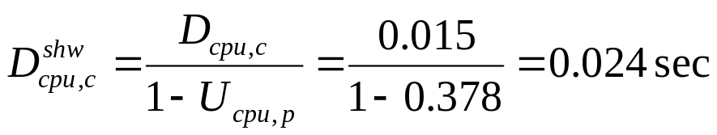
Two-Priority Example’’’’’’’’’’
2. Add the shadow CPU and the consumer class. Compute the service demands at the shadow and original CPUs as follows :
Using the MVA algorithm, the response time for the corporate class is computed as 1.04 sec and as 1.78 sec for the consumer class.

Slide 82
Two-Priority Example’’’’’’’’’’’
So there is a significant improvement in the response time of the corporate class (from 3.74 sec to 1.04 sec) with very little increase in the response time of the consumer class (2% increase).
The reason is that the consumer class has a much smaller service demand at the processor than that of the corporate class. So, giving priority to the corporate class at the processor does not hurt the lower-priority class too much.

Slide 83
SWIC Priority Algorithm
Using the notation introduced in Chapter 2, consider that there are P priority groups numbered from 1 to P. Let Prior (r) denote the priority of class r customers.
Classes in priority group 1 have the highest priority, while those in group P have the lowest one.
The SWIC algorithm builds P different models. The first model contains all classes of the highest priority (priority 1) only. The second model contains all classes of priority 1 and 2 and a shadow CPU to be used exclusively by customers of priority 2.

Slide 84
SWIC Priority Algorithm’
As in the previous example, the service demand at this shadow CPU has to be inflated by dividing the original service demand by (1 - CPU utilization of higher-priority customers).
In general, each step introduces an additional priority, an additional shadow CPU, and the service demands of the classes just included in the model are inflated.
The P different QN models considered by the SWIC algorithm are denoted Q1, ..., QP.
Figure 15.7 shows the SWIC algorithm.

Slide 85
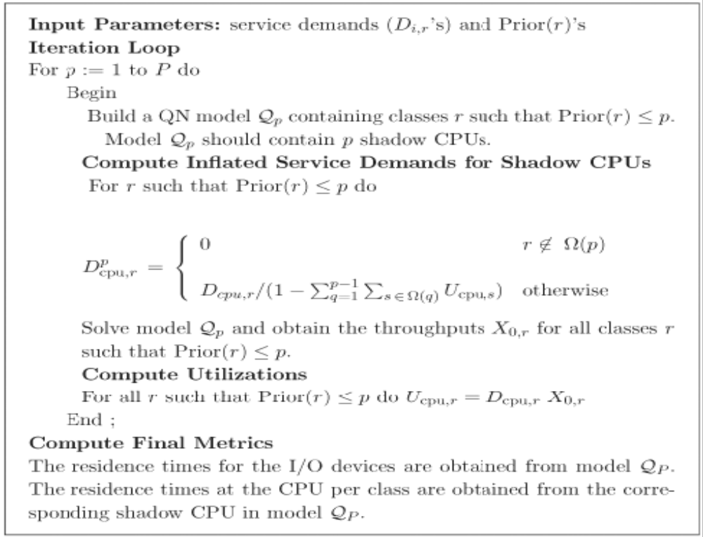
SWIC Priority Algorithm’’
Figure 15.7. SWIC algorithm for priority modeling.

Slide 86


SWIC Priority Algorithm’’’
Let indicate the service demand of a class r job of priority p at shadow CPU p. The notation
stands, as usual, for the service demand of class r jobs at the CPU. Denote by Ω(p) the set of classes of priority p. Thus, Ω(p) = {r | Prior(r) = p}.
The SWIC algorithm was shown to be very accurate.

Slide 87
Example 15.4.
Table 15.5 contains parameters for an example of the execution of the SWIC algorithm. The example has four classes and three priorities. The assignment of priorities to classes is reflected in the following Ω function :
Ω(1) = {1,2}, Ω(2) = {3}, and Ω(3) = {4}.
The system in question has one CPU and only one disk.

Slide 88
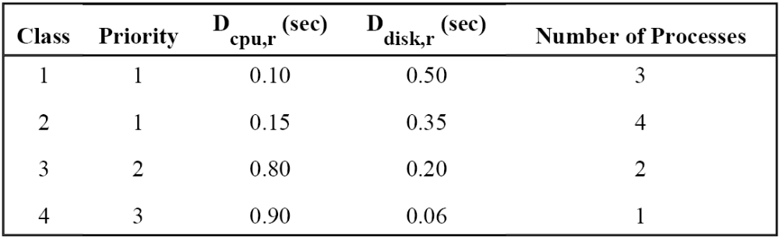
Example 15.4.’
Table 15.5. Input Parameters for SWIC Algorithm Example

Slide 89
Example 15.4.’’
Table 15.6 shows the results of the execution of the algorithm. The response times per class are 4.03 sec, 2.93 sec, 3.34 sec, and 4.08 sec, for classes 1 through 4, respectively.

Slide 90
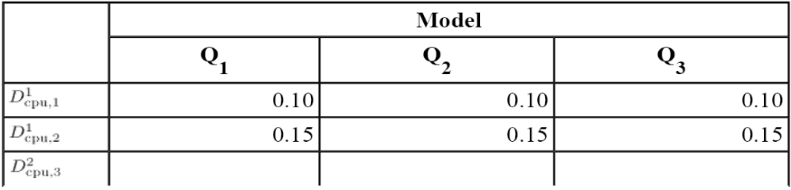
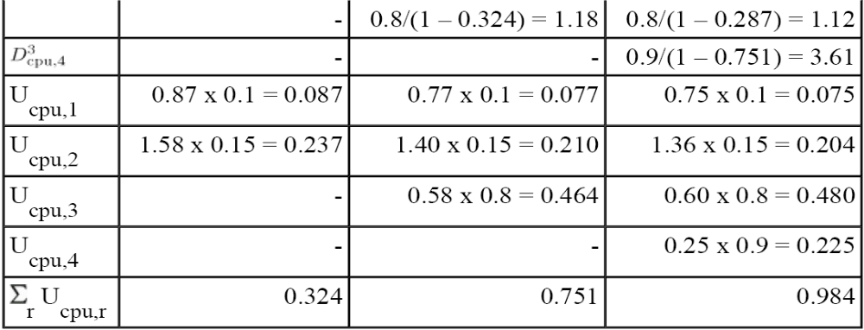
Example 15.4.’’’
Table 15.6. Results for the SWIC Algorithm Example

Slide 91
Chapter 15-Outlines
15.1. Introduction
15.2. Modeling High Service Time Variability
15.3. Modeling Blocking Effects
15.4. Modeling Priority Scheduling
15.5. Modeling Software Contention
15.6. Modeling Fork/Join Queuing Networks
15.7 Concluding Remarks
15.8 Exercises
Bibliography

Slide 92
Modeling Software Contention
The response time of a transaction or request submitted to a computer system can be broken down into three components :
  the total service time, i.e., the total time spent by transactions obtaining service from the various physical resources such as processors, disks, and networks.
  The total time spent waiting to use a physical resource.
  the time spent to access a software resource such as a non-reentrant software module, a software thread, or a database lock. (software contention)
It is important to take into account the effect of software contention when estimating the total response time.

Slide 93
Modeling Software Contention’
This section provides a simple analytical modeling technique for estimating software contention delays.
The technique, first presented in [25], is called SQNHQN and consists of a two-layer queuing network model. Software resources are modeled by a software queuing network (SQN) and physical resources by a hardware queuing network (HQN).
The effect of software contention on the physical QN and the effect of physical resource contention on the software QN requires an iterative technique to solve this dependency.

Slide 94
Modeling Software Contention’’
The technique relies on existing solution techniques for open, closed, multiclass queuing networks and can be used with both product-form QNs and approximations [3] used to handle situations such as simultaneous resource possession [3, 21, 26] and priorities [2, 3, 33] as discussed in this chapter. Multi-servers can be handled by using load-dependent servers (see Chapter 14) or approximations [34].

Slide 95

Modeling Software Contention “Single Class Algorithm”
Consider the case of N processes that alternate between executing non-critical section and critical section code. Any number of processes can be concurrently executing their non-critical code. However, only one of them can be executing the critical section code.
If a process attempts to enter its critical section code while another process is inside the critical section, the attempting process is put to sleep at the queue associated with the semaphore that controls access to the critical section.

Slide 96
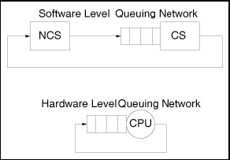
Modeling Software Contention “Single Class Algorithm” ’
Assume in this simple example that the only physical device used by all processes during the execution of the critical and non-critical section code is the CPU and that the CPU scheduling discipline is processor-sharing.
The software phases of a process execution can be depicted by a software queuing network (SQN) as in the top part of Fig. 15.8.
Figure 15.8. Software
and hardware QNs for
the critical section
example.

Slide 97
Modeling Software Contention “Single Class Algorithm” ’’
The SQN has two resources (software modules):
  One is a delay-resource (illustrated as a rectangle) that corresponds to the non-critical section code; there is no queuing for a software resource during this phase.
  The other software resource is a queuing resource, which corresponds to the critical section code.
While a process—a customer in the SQN—is using the software resources in the SQN, it is also using or waiting to use physical resources (e.g., CPUs and disks).
Delay resources are used in the SQN to represent software resources for which there is no software contention.

Slide 98
Modeling Software Contention “Single Class Algorithm” ’’’
The queuing network associated with the physical resources, the hardware queuing network (HQN), is shown in the bottom part of Fig. 15.8. Customers in the HQN are processes using the physical resources as a result of the execution of software modules.
The time spent at the NCS and CS resources in the SQN depends on the contention for access to the physical resources, the CPU in this case. Also, the number of processes contending for the CPU, i.e., the number of processes in the HQN, is equal to the number of concurrent processes that are not blocked waiting for entry to the critical section.

Slide 99
Modeling Software Contention “Single Class Algorithm” ’’’’
The blocked processes are sleeping and are therefore not present in any HQN queue. Therefore, the customer population in the HQN is equal to N – B where B is the number of processes blocked for a software resource.
Some notation needs to be defined before proceeding with an explanation on how contention for access to software resources can be computed in the single class case.

Slide 100


Modeling Software Contention “Single Class Algorithm” ’’’’’
: software-hardware service demand, i.e., total service time of a process executing software module j when using physical resource i in the HQN. The superscript "sh" indicates that these service demands are related to the mapping between the software and hardware QNs. For example, is the total CPU time for the execution of the non-critical section code. This time does not include the time spent waiting to use the CPU while executing non-critical section code.

Slide 101


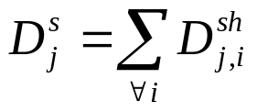
Modeling Software Contention “Single Class Algorithm” ’’’’’’
: software service demand, i.e., total service time to execute module j in the SQN. The superscript "s" indicates that this service demand relates to the software QN. For example, is the total service time to execute the non-critical section code. The service demand is the sum of all service times at all physical devices during the execution of module j. Thus,
Eq. 15.5.15

Slide 102


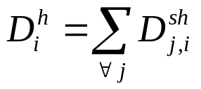


Modeling Software Contention “Single Class Algorithm” ’’’’’’’
: hardware service demand, i.e., total service time of a process at physical resource i in the hardware QN. For example, is the total service time of a process at the CPU. This time is the sum of the service demands due to the execution of all modules of the process. Thus,
Eq. 15.5.16
For example,
: residence time, i.e., total time spent by a process at physical resource i, waiting for or receiving service, when there are n processes at the HQN.

Slide 103
Single Class
“SQN-HQN Algorithm”
An iterative algorithm, the SQN-HQN algorithm, can then be used to estimate software contention time and to compute all performance metrics (e.g., response time and throughput).
The inputs to the algorithm are the service demands and the number N of processes. The algorithm iterates between solving the SQN and the HQN. Figure 15.9 illustrates the relationship between the SQN and HQN models.
The SQN model receives as input the number of processes N and the software service demands and produces the number B of processes blocked for software resources as output.

Slide 104
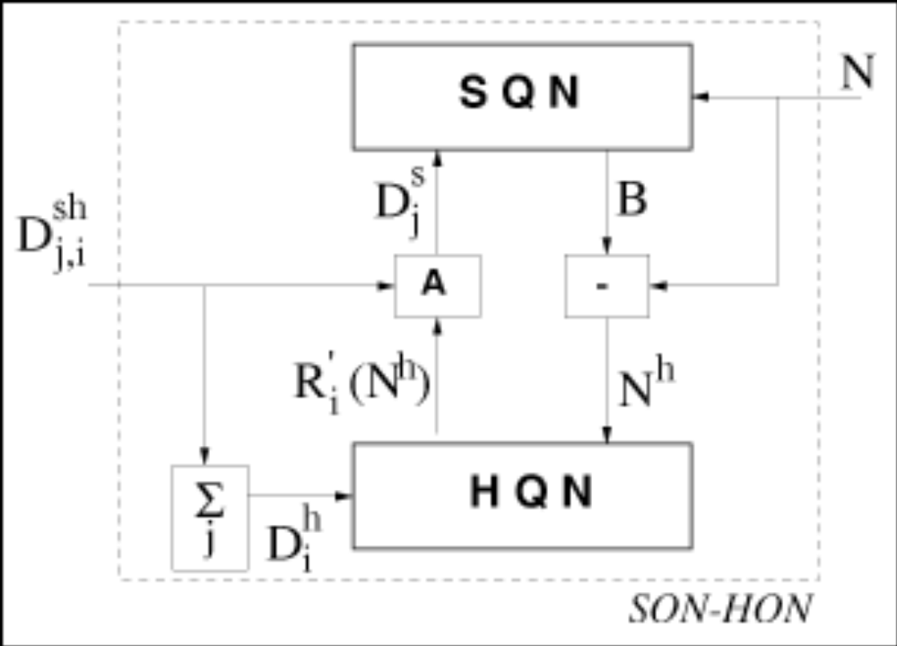
Single Class
“SQN-HQN Algorithm” ’
Figure 15.9. SQN-HQN scheme.

Slide 105

Single Class
“SQN-HQN Algorithm” ’’
The HQN model takes as input a number of customers , which is the original number of processes minus the number of processes blocked for software resources, and the hardware service demands. The output of the HQN model is the set of residence times at each physical device. These residence times are used to adjust (see step 5 of the algorithm) the software service demands for the SQN model. The iteration starts by solving the SQN assuming zero contention for physical resources.
The algorithm iterates until successive values of the number, B, of processes blocked for software contention are sufficiently close.

Slide 106
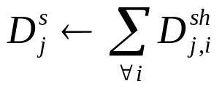
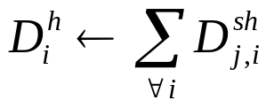


Single Class
“SQN-HQN Algorithm” ’’’
Step 1 - Initialization:
Eq. 15.5.17
Eq. 15.5.18
Eq. 15.5.19
Eq. 15.5.20
Step 2 - Solve the SQN with as service demands and N as customer population.

Slide 107




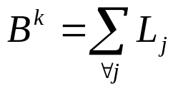

Single Class
“SQN-HQN Algorithm” ’’’’
Step 3 - Compute the average number of blocked processes . In the case of our example, this is equal to the average number of processes waiting in the queue for the CS resource. Thus, , where is the average number of processes at resource CS in the SQN and is the utilization of resource CS. In general,
Eq. 15.5.21
where is the average number of processes in the waiting line for software resource j.

Slide 108

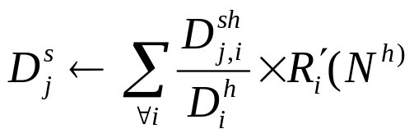
Single Class
“SQN-HQN Algorithm” ’’’’’
Step 4 - Solve the HQN with as service demands and as customer population. (Note that the solution to a QN with a non-integer customer population can be obtained using Schweitzer's approximation [35].)
Step 5 - Adjust the service demands at the SQN to account for contention at the physical resources as follows
Eq. 15.5.22

Slide 109
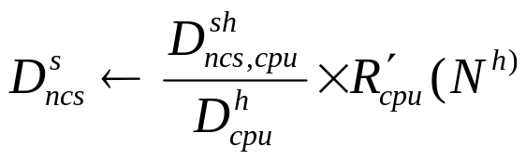
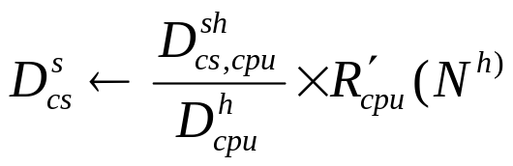
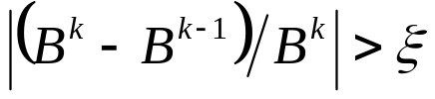

Single Class
“SQN-HQN Algorithm” ’’’’’’
Thus, for the critical section example these equations become
Eq. 15.5.23
Eq. 15.5.24
Step 6 - (Convergence Test): If then and go to step 2.

Slide 110


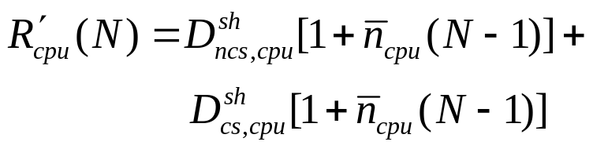
Single Class
“SQN-HQN Algorithm” ’’’’’’’
Step 5 of the above algorithm can be explained using the critical section example.
The residence time equation for MVA applied to the HQN is
Eq. 15.5.25
But,
Eq 15.5.26
Hence, using Eqs. (15.5.25) and (15.5.26), yields
Eq. 15.5.27

Slide 111
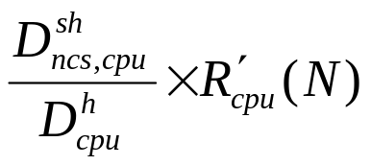
Single Class
“SQN-HQN Algorithm” ’’’’’’’’
The first term of the right-hand side of Eq. 15.5.27 is the total time (waiting + service) spent at the CPU by a process while executing non-critical section code and the second term is the total time spent at the CPU by a process while executing the critical section code.
For example, using Eqs. 15.5.25 and 15.5.27 one can write the total time spent at the CPU while executing the non-critical section code as
Eq. 15.5.28

Slide 112
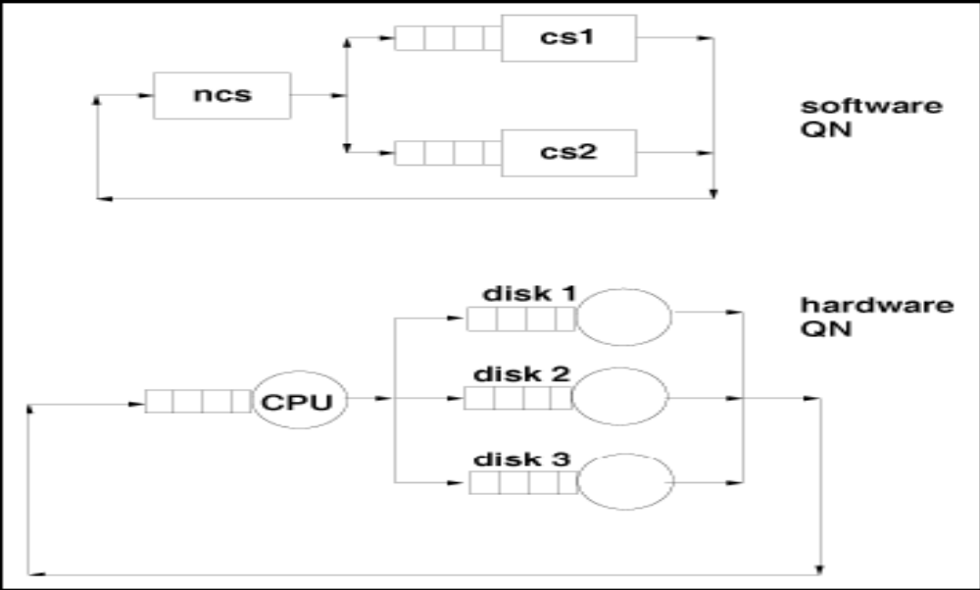
Example 15.5
Consider a computer system with one CPU and three disks (see bottom part of Fig. 15.10).
Figure 15.10. Software and hardware queuing networks for Example 15.x

Slide 113
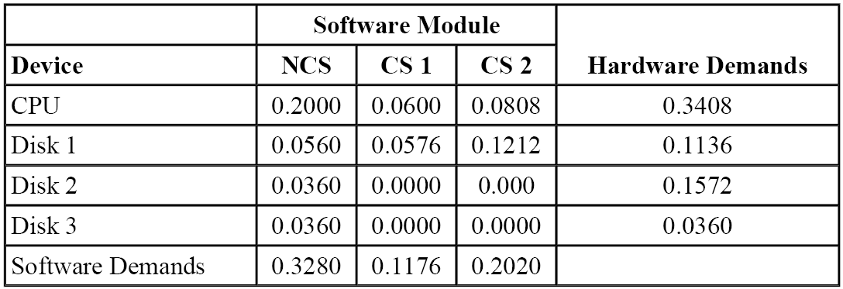
Example 15.5’
Processes execute non-critical section code and then enter one of two critical sections (see top portion of Fig. 15.10).
The service demands (i.e, the values of ) are given in Table 15.7 and are the same as in [4]. The last row shows the values of and the last column contains the values of .
Table 15.7. Service demands (in sec) for the example in [4]

Slide 114
Example 15.5’’
Table 15.8 shows the results (i.e., throughputs) obtained with the SQN-HQN algorithm and with global balance equations (i.e., exact solutions), as reported in [4], for eight values of the number of concurrent processes N.
The last column of the table shows the absolute percent relative error relative to the global balance equations solution. The error of the SQN-HQN approach is very small and does not exceed 3.05% in this example.

Slide 115
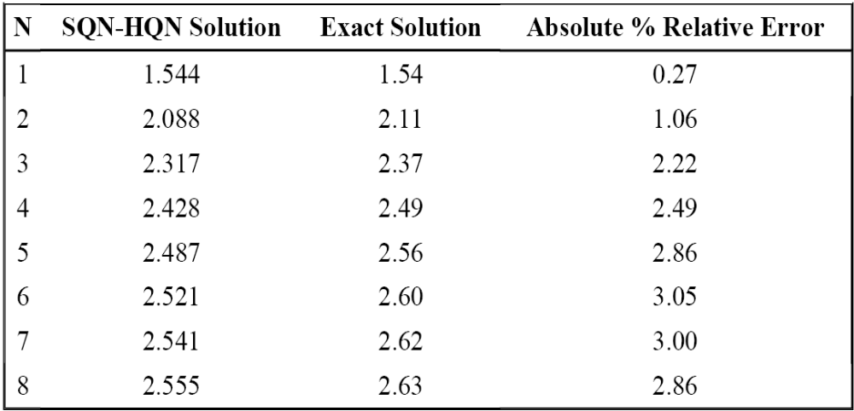
Example 15.5’’’
Table 15.8. Throughput (processes/sec) for Example 15.x

Slide 116
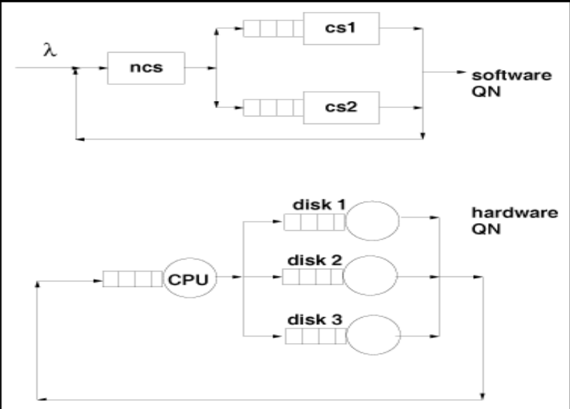
Open QN at the Software Level
The SQN-HQN technique can be extended to include the case in which the SQN is modeled as an open queuing network as illustrated in Figure 15.11.
Figure 15.11. Open QN at the software level.

Slide 117



Open QN at the Software Level’
In that case, processes arrive at a rate of req/sec. The rest of the SQN and the HQN are the same as in the example of Figure 15.10 and the service demands are as in Table 15.7.
Steps 2 and 4 of the algorithm described in Section 15.5.1 should be replaced by the following to contemplate the case of open SQNs.
  New Step 2- Solve the SQN with as service demands and as arrival rate and obtain the average number of customers in the SQN.
  New Step 4- Solve the HQN with as service demands and as customer population. (Note that the solution to a QN with a non-integer customer population can be obtained using Schweitzer's approximation [35].)

Slide 118

Open QN at the Software Level’’
Table 15.9 contains results of running the modified algorithm for the case of λ = 3 processes/sec. The table shows the results of the first 10 iterations.
Column 2 is the customer population used to solve the HQN at each iteration.
The next column shows the average response time R.
Columns 4 and 5 show the average number of requests in the SQN and the average number of blocked requests in the CS1 and CS2 queues, respectively.

Slide 119
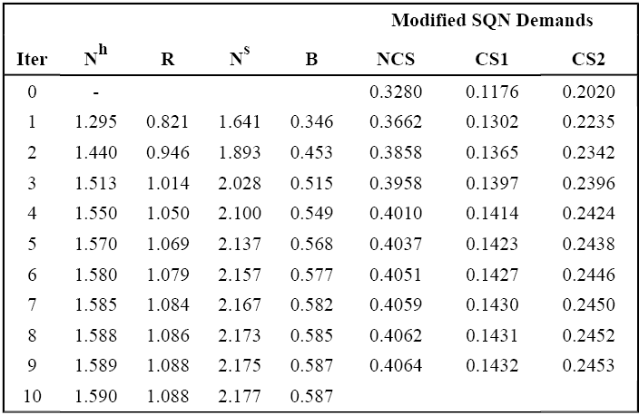
Open QN at the Software Level’’’
The last three columns show the modified service demands for the SQN at each step.
Note that the values for iteration 0 are the original values of these demands. The relative error in B is 0.123% at the tenth iteration.
Table 15.9. Results of the first 10 iterations for the open SQN example

Slide 120





Modeling Software Contention “The Multiclass Algorithm”
The algorithm presented in Section 15.5.1 generalizes in a straightforward manner to multiple classes.
A generalized notation for the multiple class case is in order. Let
R: number of classes in the SQN and in the HQN.
: population vector for the SQN.
is the multi-threading level for class r.
: population vector for the HQN.
is the number of customers in class r.
: vector of number of processes blocked, i.e., waiting for a software resource. is the number of class r processes blocked for a software resource.

Slide 121


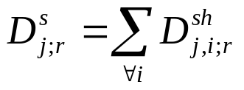
Modeling Software Contention “The Multiclass Algorithm” ’
: software-hardware service demand, i.e., total service time at physical resource i of a class r software module j.
: software service demand, i.e., total service time to execute module j of class r in the SQN. The service demand is the sum of all service times at all physical devices during the execution of module j. Thus
Eq. 15.5.29

Slide 122

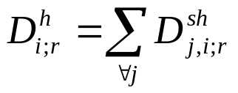


Modeling Software Contention “The Multiclass Algorithm” ’’
: hardware service demand, i.e., total service time at physical resource i for class r in the hardware QN. This time is the sum of the service demands due to the execution of all modules of a process. Thus
Eq. 15.5.30
: residence time, i.e., total time spent by a class r process at resource i, waiting for or receiving service, when the customer population at the HQN is given by the vector .

Slide 123


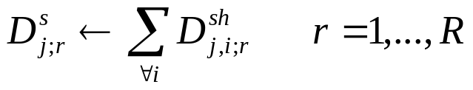
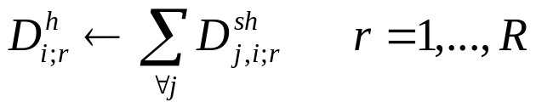
Modeling Software Contention “The Multiclass Algorithm” ’’’
The iterative algorithm used to estimate the software contention time and to compute all performance metrics (e.g., response time and throughput) is given below.
The inputs to the algorithm are the service demands and the vector .
The algorithm iterates until successive values of are sufficiently close.
Step 1 - Initialization:
Eq. 15.5.31
Eq. 15.5.32

Slide 124


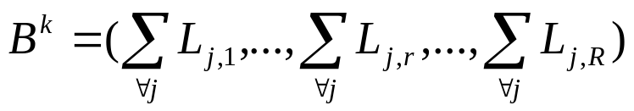

Modeling Software Contention “The Multiclass Algorithm” ’’’’
Eq. 15.5.33
Eq. 15.5.34
Step 2 - Solve the SQN with as service demands and as customer population.
Step 3 - Compute the average number of blocked processes per class as
Eq. 15.5.35
where is the average number of class r processes in the waiting line for software resource j.

Slide 125



Modeling Software Contention “The Multiclass Algorithm” ’’’’’
Step 4 - Solve the HQN with as service demands and population vector as customer population. Note that the solution to a QN with a non-integer customer population can be obtained using Schweitzer's approximation [35].
The solution to the HQN provides the residence time values for all devices i and classes r.
Step 5 - Adjust the service demands at the SQN to account for contention at the physical resources as follows
Eq. 15.5.36

Slide 126


Modeling Software Contention “The Multiclass Algorithm” ’’’’’’
Step 6 (Convergence Test):
If then and go to step 2.
The same considerations discussed in Section 15.5.1 can be applied to the multiclass case. Situations that require modeling a queue for a multi-threaded software server can be considered by including a multi-server queue in the SQN and using approximation techniques [34] to solve QNs with multi-servers or QNs with load-dependent servers as done in Chapter 14.

Slide 127
Chapter 15-Outlines
15.1. Introduction
15.2. Modeling High Service Time Variability
15.3. Modeling Blocking Effects
15.4. Modeling Priority Scheduling
15.5. Modeling Software Contention
15.6. Modeling Fork/Join Queuing Networks
15.7 Concluding Remarks
15.8 Exercises
Bibliography

Slide 128
Modeling Fork/Join Queuing Networks
Parallelism and concurrency in computer systems can be modeled by fork-join systems.
When entering a concurrent processing stage, an arriving request forks into subtasks that are executed independently either on different service centers or on the same service center. Upon completing execution, each subtask waits at the join point for its sibling tasks to complete execution.
The fork operation starts new concurrent subtasks. The join operation forces one subtask to wait for sibling subtasks.

Slide 129
Modeling Fork/Join Queuing Networks’
Fork/join queuing networks are used to model disk arrays under synchronous workloads [38]. The cache, the array controller, and the disks are represented by individual queuing service centers.
The controller is modeled by a fork/join queue. Each disk is modeled by a queuing server of this fork/join queue.
A request to the controller is forked into sub-requests that are assigned to the disks of the disk array. An I/O request to the disk array is complete when all sub-requests are complete, i.e., when they all meet at the join point.

Slide 130
Modeling Fork/Join Queuing Networks’’
Performance models of modern servers and operating systems typically involve solving a set of non-product form closed QNs with fork/join structures. In these models, fork/join stations model the synchronization constraints between processes at different stages of execution.
Obtaining the exact solution for these networks is difficult and may be costly in the case of systems with a large state space. Therefore, approximate methods are needed.
This section presents the approximate solution technique proposed in [39, 40] for queuing models with fork/join synchronization.

Slide 131

Modeling Fork/Join Queuing Networks’’’
Consider that the QN consists of one or more interconnected subsystems as illustrated in the example of Fig. 15.12.
Figure 15.12. Fork and join.

Slide 132
Modeling Fork/Join Queuing Networks’’’’
Two types of subsystems are considered :
1. Serial subsystem : consists of a single queuing service center like the ones discussed throughout the book.
2. Parallel subsystem : consists of k (k > 1) parallel service centers in a fork/join arrangement. That is, a request to a parallel subsystem is split into k independent sub-requests, one for each of the k service centers. The original request completes when all sub-requests complete, i.e., when all of them arrive at the join point. Thus, the time spent by a request in a parallel subsystem is the maximum of the times spent in each of the k service centers.

Slide 133
Modeling Fork/Join Queuing Networks’’’’’
The average service time of a request is assumed to be the same at each of the k service centers of a parallel subsystem.
Note that a serial subsystem is a special case of a parallel subsystem when k = 1.

Slide 134





Modeling Fork/Join Queuing Networks’’’’’’
Consider a closed fork/join queuing network with the following parameters :
I : number of subsystems in the queuing network model.
: average service time at subsystem i.
: number of parallel service centers at subsystem i.
: response time at subsystem i when there are n requests in the queuing network.
: residence time at subsystem i when there are n requests in the queuing network.
: average number of visits per request to subsystem i.

Slide 135




Modeling Fork/Join Queuing Networks’’’’’’’
The approximate fork/join MVA solution method is based on adapting the response time equation as indicated by Eq. 15.6.37, which is an approximation derived from the arrival theorem [30].
Eq. 15.6.37
where is the average queue length at subsystem i when there is one less customer in the QN and is the -th harmonic number defined as

Slide 136



Modeling Fork/Join Queuing Networks’’’’’’’’
When k = 1, Eq. (15.6.37) becomes the exact MVA response time equation since .
According to Eq. 15.6.37, when there is only one request in the queuing network the average response time at a parallel subsystem with service centers is .
The harmonic number accounts for the synchronization time at the joining point. The rationale for this approximation comes from the fact that the expectation of a random variable defined as the maximum of k exponentially distributed random variables with average S is equal to .

Slide 137


Modeling Fork/Join Queuing Networks’’’’’’’’
Performance measures for a fork/join queuing network are then obtained through the following approximate MVA equations :
Eq. 15.6.38
Eq. 15.6.39
Eq. 15.6.40
The relative error of this approximation was shown to be less than 5% for the majority of the cases analyzed [39].

Slide 138


Example 15.6.
A database server consists of a powerful processor and two disk array subsystems, 1 and 2. The disk arrays operate under synchronous workload, i.e., transactions are blocked until their I/O requests complete service. A disk array improves I/O performance by striping data across multiple disks [38]. The disk array subsystems consist of and disks, respectively. A transaction alternates between using the processor and the I/O subsystem until it completes its execution. Previous measurements indicate that the average response time is 0.34 sec when 10 transactions are executing concurrently.

Slide 139
Example 15.6.’
One of the SLAs for the database server is that the average response time should not exceed 1 second. Before increasing the concurrency level to 50 transactions, the performance analyst wants to predict the new response time to verify whether or not the response time SLA will continue to be satisfied.

Slide 140


Example 15.6.’’
The model parameters are as follows :
The processor service demand is equal to 0.01 sec and the service demands for each disk of disk arrays 1 and 2 are 0.02 and 0.03, respectively.
With the purpose of keeping the example simple, the number of parallel disks in the disk arrays is set to small values, i.e., and .
The queuing model of the database server has three subsystems, the processor and the two storage systems, with two and three disks, respectively.

Slide 141
Example 15.6.’’’
The model is closed with n transactions in execution. Typically a disk array has three components, the cache, the controller and the disks.
The disk array in this example is modeled by separate and parallel services centers, such that caching effects as well as controller overheads are implicitly represented in the disk service demands. Each disk array is modeled by parallel subsystem with a fork/join structure, where each disk is a queuing server.

Slide 142




Example 15.6.’’’’
The parameters for the QN model are :
n = 50,
I = 3 (i.e., three subsystems),
(serial execution at the processor),
, (parallel execution at the disk arrays),
,
, and
.
The solution of the algorithm presented in this section provides an average response time of 1.53 sec, which exceed the SLA of 1 second (see the MS Excel workbook Ch15-Ex15-6.XLS).

Slide 143
Chapter 15-Outlines
15.1. Introduction
15.2. Modeling High Service Time Variability
15.3. Modeling Blocking Effects
15.4. Modeling Priority Scheduling
15.5. Modeling Software Contention
15.6. Modeling Fork/Join Queuing Networks
15.7 Concluding Remarks
15.8 Exercises
Bibliography

Slide 144
Concluding Remarks
Several important aspects of actual computer systems such as
  service times with high variability,
  priority scheduling at the CPU,
  software contention,
  blocking, and
  fork and join,
are not amenable to modeling with exact queuing network models.
Various approximations based on Mean Value Analysis are presented in this chapter in order to deal with these situations.

Slide 145
Chapter 15-Outlines
15.1. Introduction
15.2. Modeling High Service Time Variability
15.3. Modeling Blocking Effects
15.4. Modeling Priority Scheduling
15.5. Modeling Software Contention
15.6. Modeling Fork/Join Queuing Networks
15.7 Concluding Remarks
15.8 Exercises
Bibliography

Slide 146



Exercises
Derive Eqs. 15.2.4 and 15.2.5. (Hint:
where is the second moment of a random variable and its mean.)
2. Consider the example of Section 15.3.2.
  Use the open multiclass model of Chapter 13 to solve the unconstrained model.
  Consider the example of Section 15.4.1. Assume that consumer requests have priority at the CPU over corporate requests. Compute the resulting response time.
3. Consider the example of Section 15.4.1. Assume that consumer requests have priority at the CPU over corporate requests. Compute the resulting response time.

Slide 147


Exercises’
4. An iterative approach for modeling priorities was presented by Lazowska et al. [23]. In their approach they suggest that one model with P shadow CPUs be built. The service demands have to be inflated properly in the same way as discussed in the algorithm given in Figure 15.7. However, this requires knowing the values of the utilizations for the various classes. Since the utilization is equal to , the algorithm starts by assuming an initial value of zero for all throughputs. MVA can now be used to solve the QN and obtain new values of the throughputs, which are used to compute the utilizations and therefore new values of the service demands for the shadow CPUs.

Slide 148
Exercises’’
4.(cont’d) This process continues until the throughput values converge within a given tolerance. Write a program that implements this algorithm and use it to solve the example given in Section 15.4.2.

Slide 149
Bibliography
[1] J. Almeida, M. Dabu, A. Manikutty and P. Cao, "Providing Differentiated Quality-of-Service in Web Hosting Services," Proc. ACM SIGMETRICS Workshop on Internet Server Performance, Madison, Wisconsin, June 1998.
[2] V. A. Almeida and D. A. Menascé, "Approximate modeling of CPU preemptive resume priority scheduling using operational analysis," Proc. 10th European Computer Measurement Association (ECOMA) Conf. Computer Measurement, Munich, Germany, October 12-15, 1982.
[3] S. Agrawal, Metamodeling: A Study of Approximations in Queuing Models, MIT Press, Cambridge, Massachusetts, 1985.

Slide 150
Bibliography’
[4] S. Agrawal and J. P. Buzen, "The Aggregate Server Method for Analyzing Serialization Delays in Computer Systems," ACM Tr. Comp. Sys., vol. 1, no. 2, May 1983, pp. 116–143.
[5] B. Krishnamurthy and J. Rexford, Web protocols and practice: HTTP/1.1, networking protocols, caching and traffic measurement, Addison Wesley, Boston, Massachusetts, 2001.
[6] G. Banga and P. Druschel, "Measuring the capacity of a web server," Usenix Symp. Internet Technol. Syst., Monterey, California, December 1997, pp. 61–71.
[7] P. Barford and M. Crovella, "Generating representative Web workloads for network and server performance evaluation," Proc. ACM SIGMETRICS Conf., Madison, Wisconsin, November 1998, pp. 151–160.

Slide 151
Bibliography’’
[8] F. Baskett, K. Chandy, R. Muntz, and F. Palacios, "Open, closed, and mixed networks of queues with different classes of customers," J. ACM, vol. 22, no. 2, April 1975, pp. 248–260.
[9] L. Bertolotti and M. Calzarossa, "Models of mail server workloads,“ Performance Evaluation, no. 46, vol. 2, 2001, pp. 65–76.
[10] A. Brandwajn, "Fast approximate solution of multiprogrammed models,“ Proc. 1982 SIGMETRICS Conf. Measurement and Modeling of Computer Systems, Seattle, Washington, 1982, pp. 141-149.
[11] G. Bolch, S. Greiner, H. de Meer, and K. Trivedi, Queueing Networks and Markov Chains, John Wiley & Sons, Inc., 1998.
[12] M. Carey, R. Jauhari, M. Livny, "Priority in DBMS resource scheduling,“ Proc. VLDB Conf., 1989, pp. 397–410.

Slide 152
Bibliography’’’
[13] K. Chandy and E. Sauer, "Approximate methods for analyzing queuing network models of computing systems," ACM Computing Surveys, vol. 10, no. 3, September 1978, pp. 281–317.
[14] P. Courtois, "Decomposability, instabilities, and saturation in multiprogramming systems," Comm. ACM, vol. 18, no. 7, 1975, pp. 371-377.
[15] M. Crovella and A. Bestravos, "Self-similarity in World Wide Web traffic: evidence and possible causes," in IEEE/ACM Transactions on Networking, vol. 5, no. 6, December 1997, pp. 835–846.
[16] L. W. Dowdy, D. Eager, K. Gordon, and L. Saxton, "Throughput concavity and response time convexity," Information Processing Letters, no. 19, 1984.

Slide 153
Bibliography’’’’
[17] A. Downey, "The structural cause of file size distributions," Proc. IEEE MASCOTS 2001, Cincinnati, Ohio, August 2001.
[18] D. Eager, D. Sorin, and M. Vernon, "AMVA techniques for high service time variability," Proc. 2000 ACM SIGMETRICS Int'l. Conf. on Measurement and Modeling of Computer Systems, Santa Clara, California, June 2000, pp. 217– 228.
[19] A. Feldmann, A. Gilbert, P. Huang, and W. Willinger, "Dynamics of IP traffic: a study of the role of variability and the impact of control," Proc. ACM SIGCOMM Conf., Boston, Massachusetts, September 1999, pp. 301– 313.

Slide 154
Bibliography’’’’’
[20] P. A. Jacobson and E. D. Lazowska, "A reduction technique for evaluating queuing networks with serialization delays," Performance'83, eds. A. K. Agrawal and S. K. Tripathi, North-Holland Publishing Co., Amsterdam, 1983, pp. 45–59.
[21] P. A. Jacobson and E. D. Lazowska, "Analyzing queuing networks with simultaneous resource possession," Comm. ACM, 25, 2, February 1982, pp. 142– 151.
[22] P. Kahkipuro, "Performance modeling framework for CORBA-based distributed systems," Ph.D. Dissertation, Technical Report A-2000-3, Department of Computer Science, University of Helsinki, Finland, 2000.

Slide 155
Bibliography’’’’’’
[23] E. Lazowska, J. Zahorjan, S. Graham, and K. C. Sevcik, Quantitative System Performance: Computer System Analysis Using Queuing Network Models, Prentice Hall, Upper Saddle River, New Jersey, 1984.
[24] D. A. Menascé and V. A.F. Almeida, "Operational analysis of multiclass systems with variable multiprogramming level and memory queuing," Computer Performance, vol. 3, no. 3, September 1982.
[25] D. A. Menascé, "Two-level iterative queuing modeling of software contention," Proc. Tenth IEEE/ACM International Symposium on Modeling, Analysis and Simulation of Computer and Telecommunication Systems (MASCOTS 2002), Fort Worth, Texas, October 12-16, 2002.

Slide 156
Bibliography’’’’’’’
[26] D. A. Menascé, O. Pentakalos, and Y. Yesha, "An analytic model of hierarchical mass storage systems with network-attached storage devices," Proc. 1996 ACM Sigmetrics Conf., Philadelphia, Pennsylvania, May 1996.
[27] D. Menascé, V. A. F. Almeida, R. Riedi, F. Ribeiro, R. Fonseca, and W. Meira Jr., "A hierarchical and multiscale approach to analyze E-business workloads," Performance Evaluation, vol. 54, no. 1, September 2003, pp. 33–57.
[28] V. Paxson and S. Floyd, "Wide area traffic: the failure of Poisson modeling,"IEEE/ACM Tr. Networking, vol. 3, no. 3, June 1995, pp. 226–244.

Slide 157
Bibliography’’’’’’’’
[29] S. Ramesh and H. G. Perros, "A multilayer client-server queuing network model with synchronous and asynchronous messages," IEEE Tr. Software Eng., vol. 26, no. 11, November 2000, pp. 1186–1100.
[30] M. Reiser and S. Lavenberg, "Mean-value analysis of closed multi-chain queuing networks," J. ACM, vol. 27, no. 2, 1980, pp. 643–673.
[31] M. Reiser, "A queueing network analysis of computer communication networks with window flow control," IEEE Trans. on Commun., vol. 27, no. 8, August 1979.
[32] J. Rolia K. C. Sevcik, "The Method of Layers," IEEE Tr. Software Eng., vol. 21, no. 8, 1995, pp. 689–700.

Slide 158
Bibliography’’’’’’’’’
[33] K. C. Sevcik, "Priority Scheduling Disciplines in Queuing Network Models of Computer Systems," Proc. IFIP Congress 77, North-Holland Publishing Co., Amsterdam, 1977, pp. 565–570.
[34] A. Seidmann, P. Schweitzer, and S. Shalev-Oren, "Computerized closed queueing network models of flexible manufacturing systems," Large Scale Syst. J., North-Holland, vol. 12, pp. 91–107, 1987.
[35] P. Schweitzer, "Approximate analysis of multiclass closed network of queues," in International Conf. Stochastic Control and Optimization, Amsterdam, 1979.
[36] A. Thomasian, "Queuing network models to estimate serialization delays in computer systems," in Performance'83, A. K. Agrawal and S. K. Tripathi (eds.), North-Holland Publishing Co., Amsterdam, 1983, pp. 61–81.

Slide 159
Bibliography’’’’’’’’’’
[37] A. Thomasian and P. Bay, "Analysis of queuing network models with population size constraints and delayed blocked customers," Proc. 1984 ACM SIGMETRICS Conf. Measurement and Modeling of Computer Systems, Boston, Massachusetts, 1984.
[38] E. Varki, A. Merchant, J. Xu, and X. Qiu, "An integrated performance model of disk arrays," Proc. IEEE MASCOTS Conf., Orlando, Florida, 2003.
[39] E. Varki, "Mean value technique for closed fork-join networks," Proc. ACM SIGMETRICS Conf. Measurement and Modeling of Computer Systems, Atlanta, Georgia, May 1999, pp. 103 – 112.
[40] E. Varki and L. W. Dowdy, "Analysis of balanced fork-join systems," Proc. ACM SIGMETRICS Conf. Measurement and Modeling of Computer Systems, Philadelphia, Pennsylvania, May 1996.

Slide 160
Bibliography’’’’’’’’’’’
[41] J. Zahorjan, E. Lazowska, and R. Garner, "A decomposition approach to modelling high service time variability," Performance Evaluation, vol. 3, no. 1, pp. 35–53.
[42] C. M. Woodside, "An active-server model for the performance of parallel programs written using rendezvous," J. Systems and Software, 1986, pp. 125–131.

